Slide 1
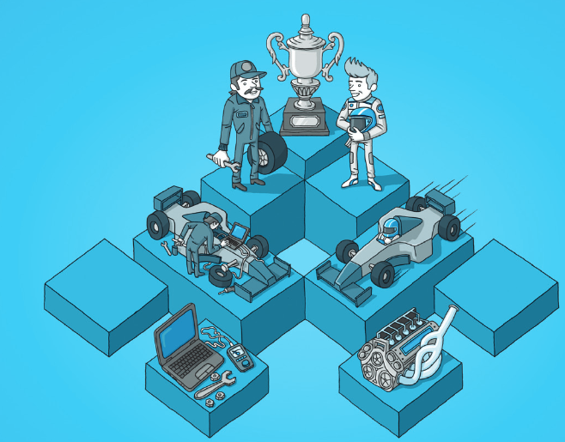
Impact Mapping Workshop
Copyright © Gojko Adzic
Author: Gojko Adzic
Facilitated by John Hughes and Rachel Whitt

Slide 2
Objectives for this Impact Mapping Workshop
Key Learning Outcomes:
How to create impact maps
How thinking about impactful alignment to goals makes it easy to propose beneficial deliverables
How impact maps make prioritization easy – drive roadmaps
How to create or split stories using an impact map

Slide 3

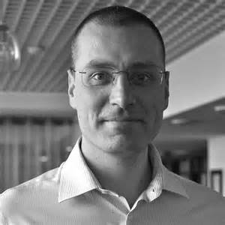
What Is Impact Mapping
Gojko Adzic
Impact Mapping is an amalgamation of several existing tools and practices to provide one “super-practice” for strategic planning that prevents organizations from losing sight of their mission, goals, and objectives
Other Resources:
www.impactmapping.org
https://github.com/impactmapping/open-impact-mapping-workshop
https://www.impactmapping.org/book.html

Slide 4
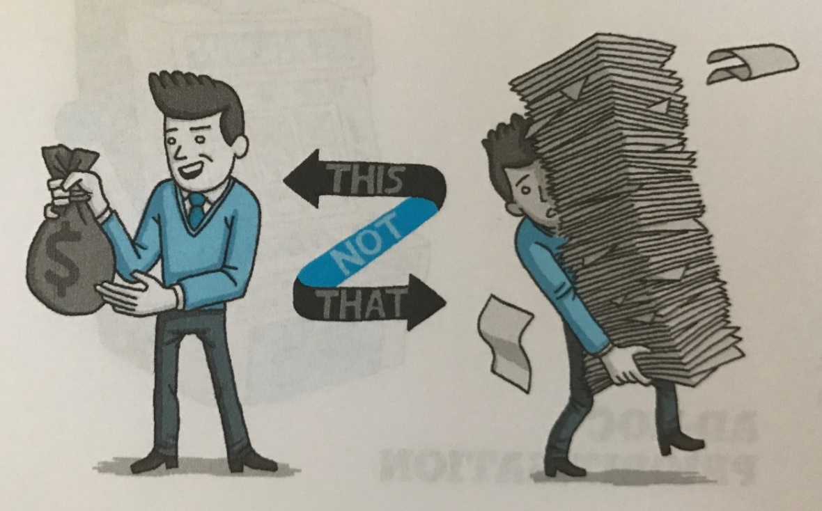
Why Impact Mapping
Keeps focus on business goals
Promotes collaboration
Identifies underlying assumptions
Facilitates ongoing Roadmap management
Create better User Stories
Deliver business goals, not just ship software

Slide 5
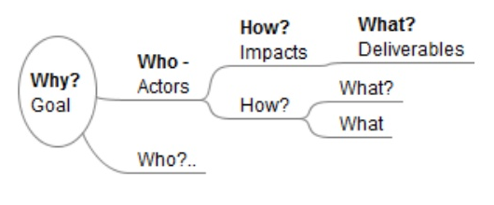
Elements of an Impact Map
Goal
Why are we doing this
Actors
Who will be impacted by this?
Who can help to achieve the goal?
Who can obstruct?
Who is a part of building, consuming, or influencing the solution
Impacts
How will this impact them?
How should their behaviour change?
How can they help?
How can they obstruct?
Deliverables
What can we do/deliver to cause an impact
**Measurements
Goal – what amount of change do we desire to achieve
Deliverables – what amount of change will this deliverable make towards our goal

Slide 6
Outputs of an Impact Mapping Session
The Impact Map itself
The discussion
The ability to prioritize your roadmap and backlog according to measurable assumptions
The ability to create user stories directly from your Impact Map
As an “Actor,” I want to “Deliverable,” So that I may “Impact” [In order to achieve Goal]
A set of experiments and measures that you can monitor through dashboards and other visual radiators

Slide 7
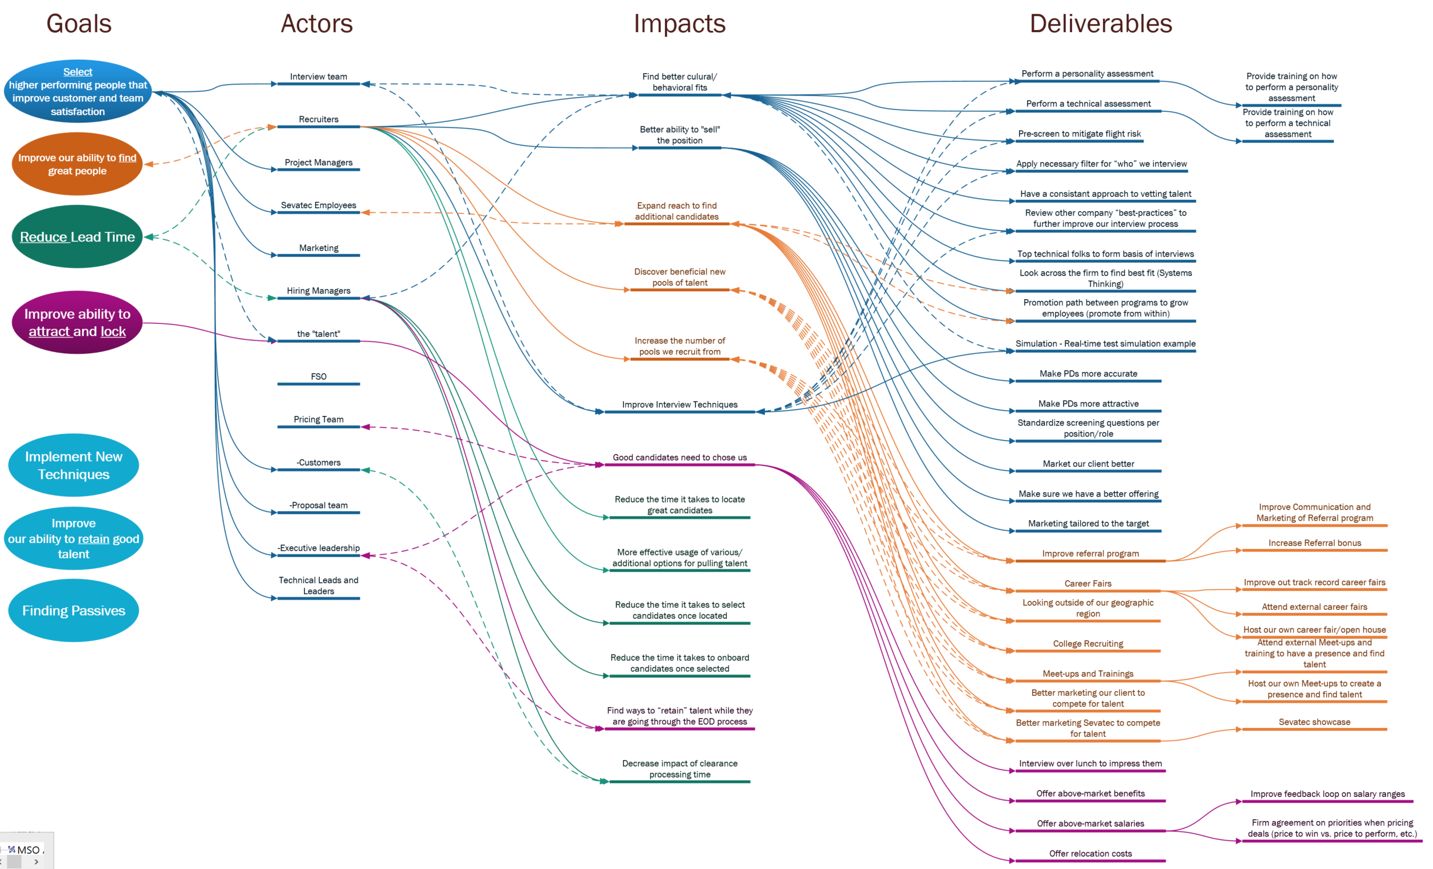
An Example

Slide 8
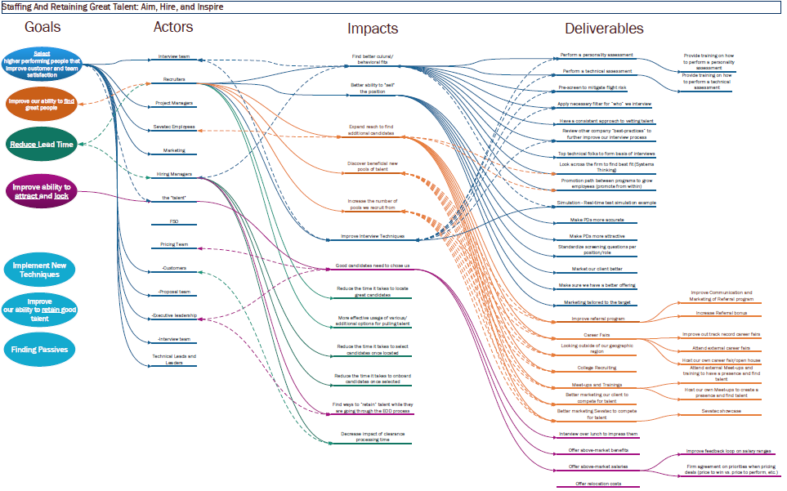
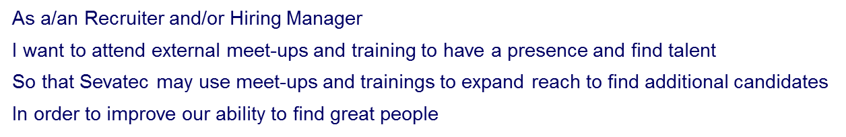
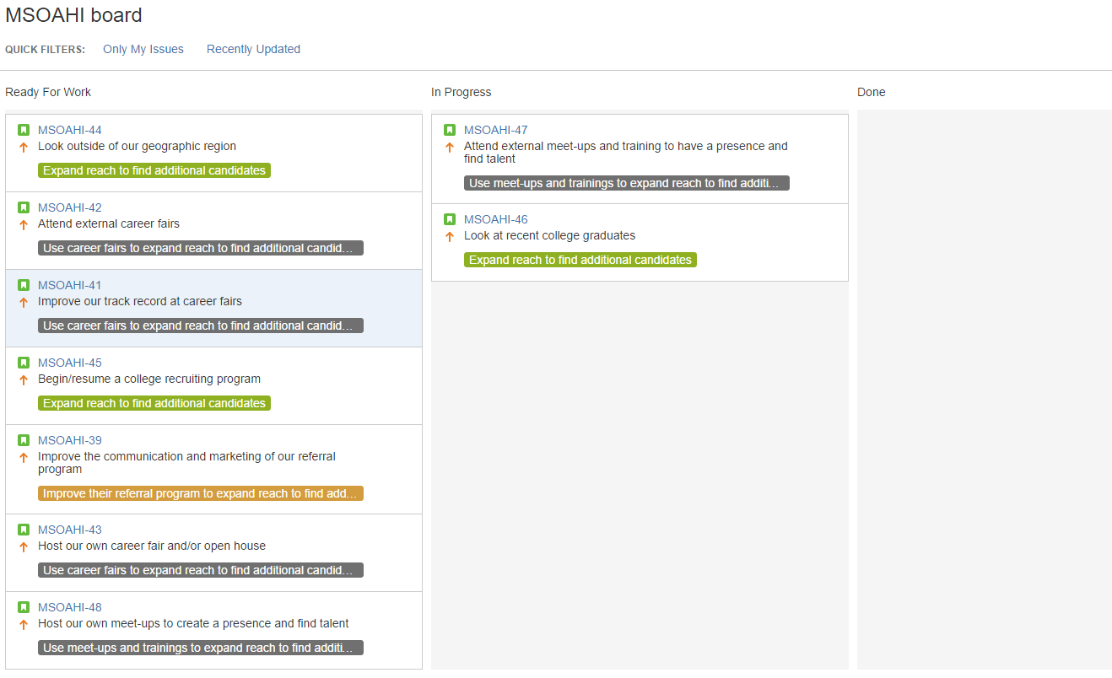
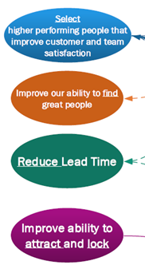
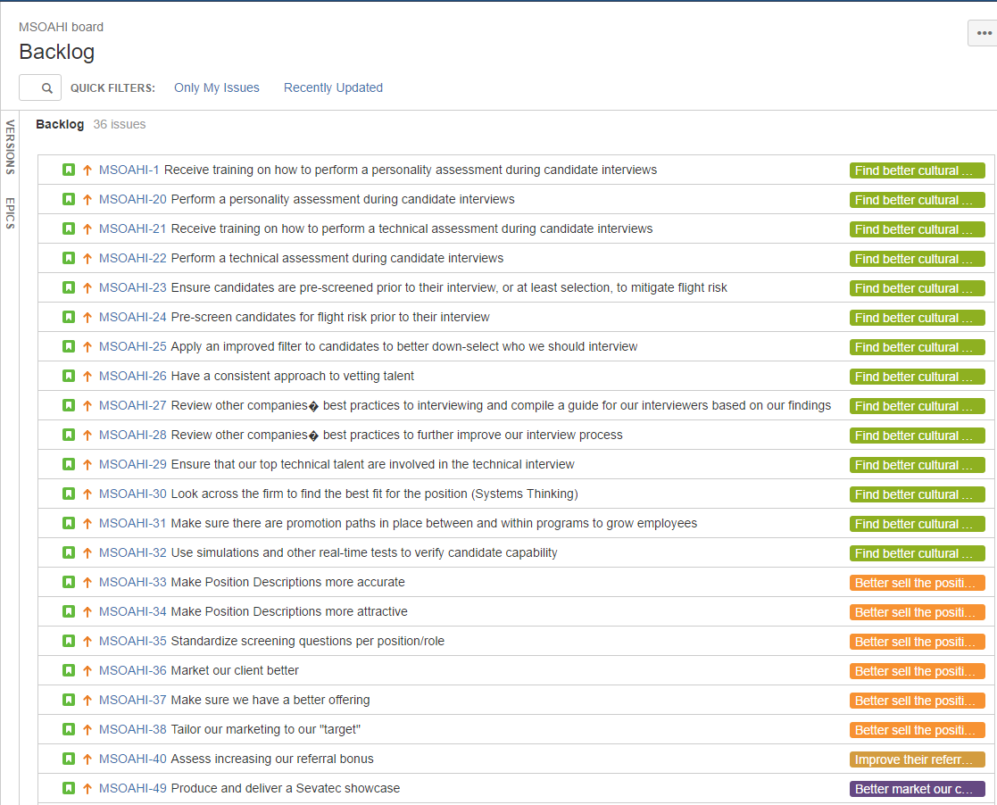
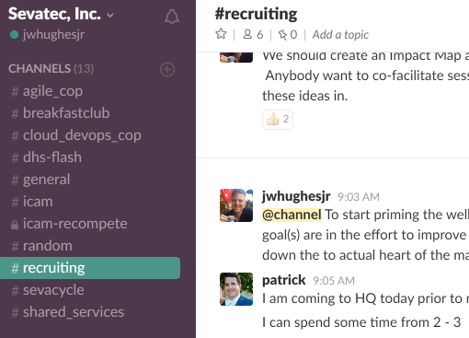
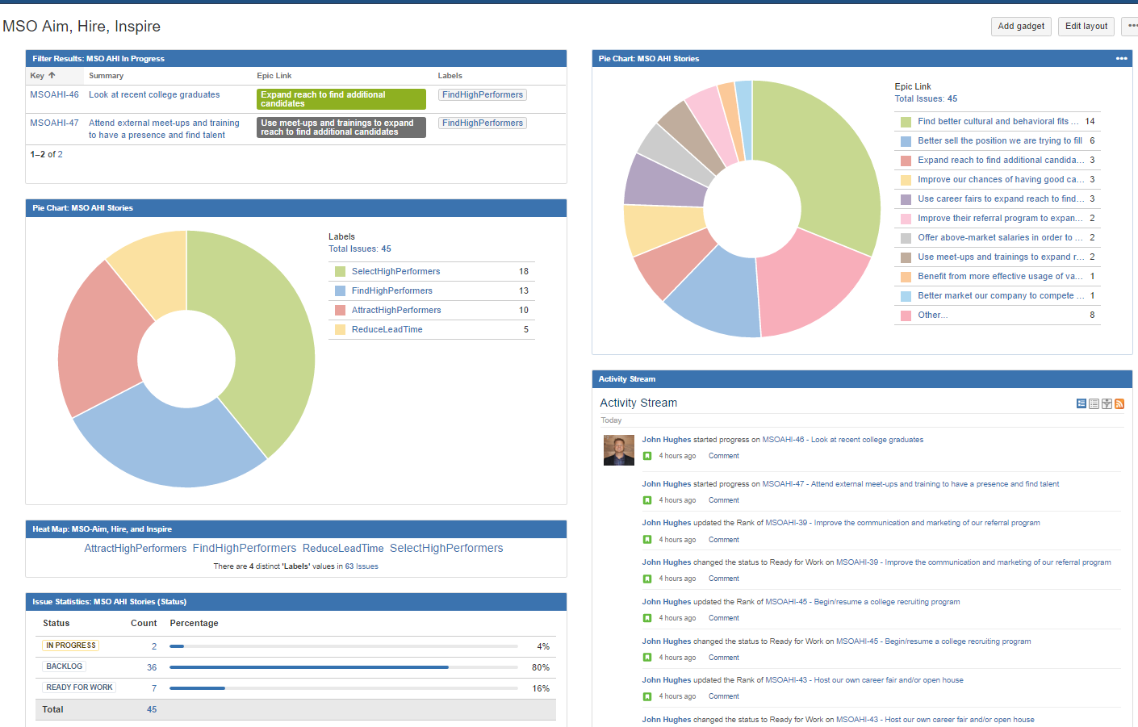
The Big Picture of How the Process and Tools Can Fit Together
Goals and Objectives
Backlog of actions to persist and provide order
Kanban Board to manage near term effort
Impact map to align actions to goals
Dedicated Slack channel to facilitate persistent communication
Dashboard to keep big picture goals and progress in sight

Slide 9
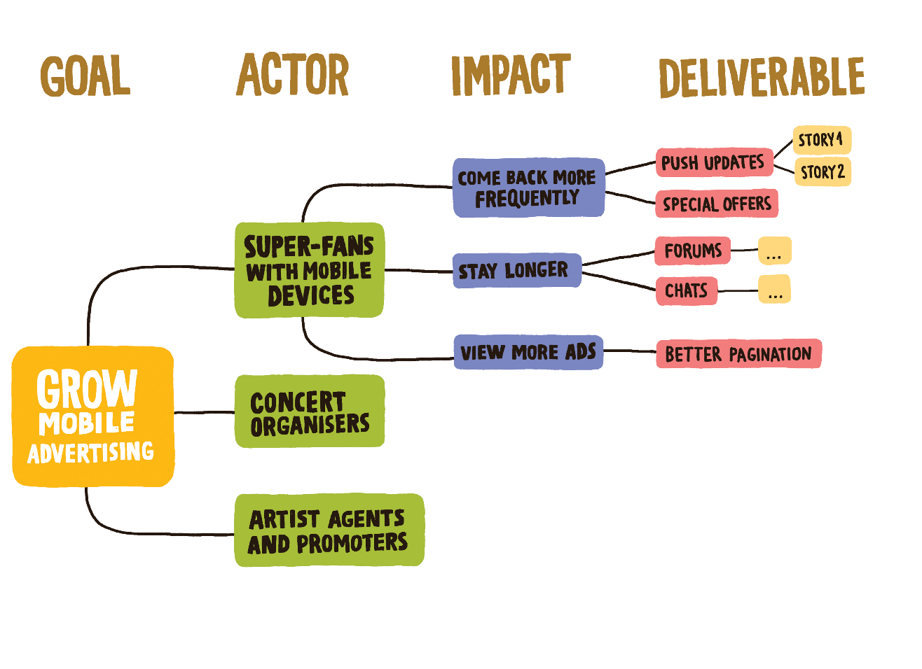
The Workshoppy Part
Let’s build an Impact Map

Slide 10
Preparing Your Goals
12 Minutes Total
4 minutes to go through slides
8 minutes to plan goals
Discover Goals
Define Good Measures
Pick your top goal to continue working with

Slide 11
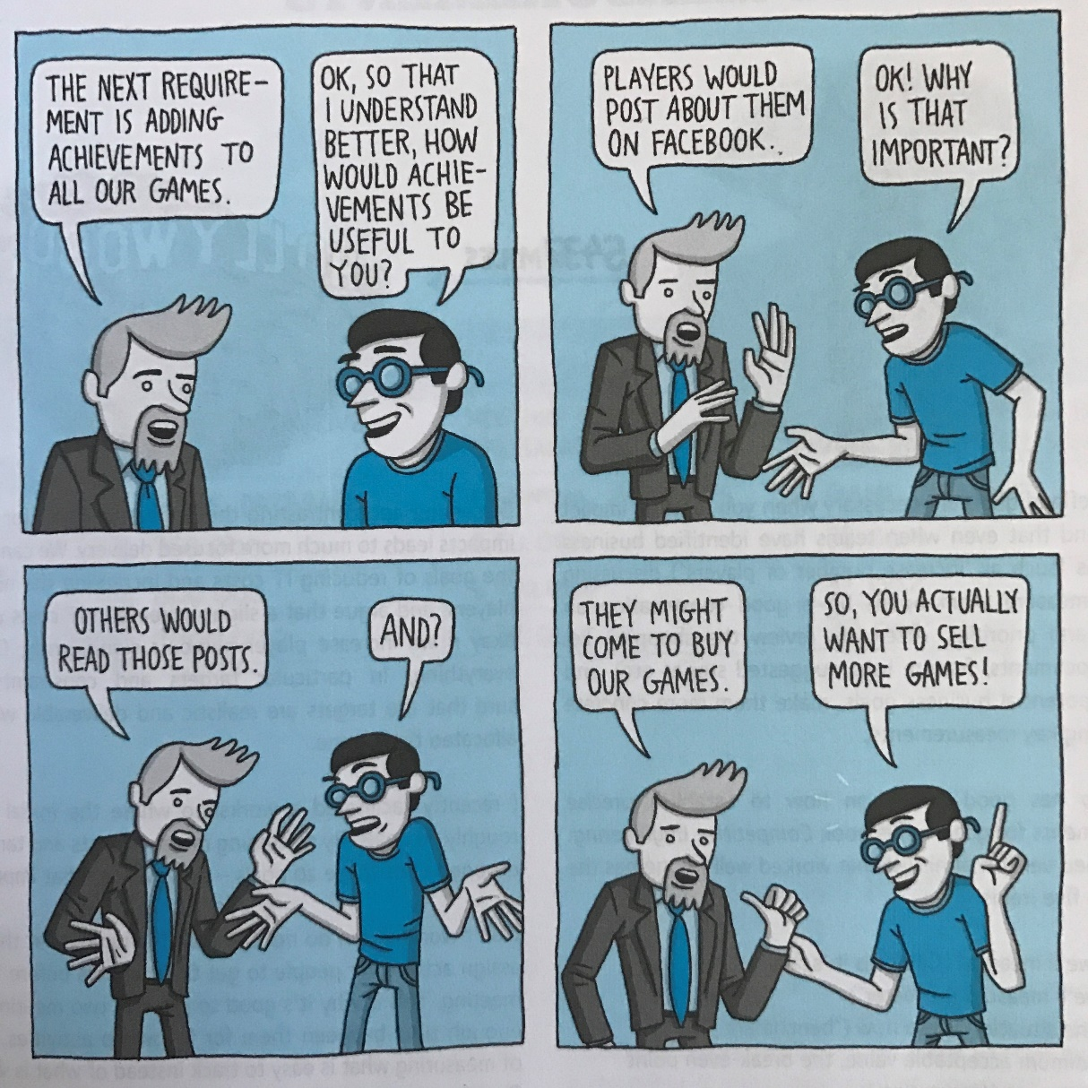
Preparation Step 1: Discover Goals
Start with a mission statement
List of < 3-5 goals
If you end up starting with features (ugh!) then ask questions about each like “why is this important” or “how will it be useful” – or use Lean 5 Whys to determine the actual goals

Slide 12
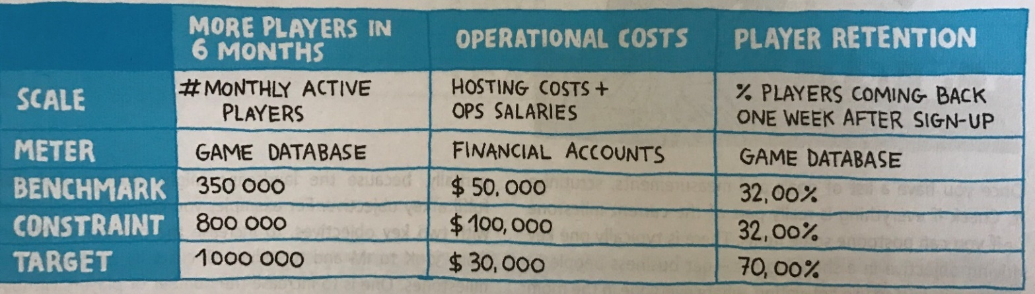
Preparation Step 2: Define Good Measurements
(Scale) What we will measure
(Meter) How we will measure it
(Benchmark) What it is now
(Constraint) Minimum acceptable value
(Target) The desired value
A few notes on Measurements
Name them whatever works for you
The discussion itself is very beneficial
Measure what is valuable, not what is easy to track
Measure outcomes
Large assumptions have a lot of uncertainty with a high risk of being wrong

Slide 13


Preparation Step 3: Plan Your First Milestone
Take 8 Minutes To Plan Your Goal(s)
Assess your list of goals and measurements
Order them by importance to organization mission using techniques such as dot voting
Choose the top goal as your first milestone to map

Slide 14
Now You Are Ready To Hold an Impact Mapping Session
Bring together no more than five to eight people who are interested in or affected by achieving your prepared goal(s)
Optimally, these should include a mixture of:
Domain experts from among the internal stakeholders
Developers/designers from the team that will work on the goal’s implementation
Product Owner or Relevant managers, for example product managers or development team manager
Have a big white board cleared off with plenty of Stickies and Sharpies
You can also use an electronic tool, but this may be cumbersome and slow for such a collaborative group activity

Slide 15
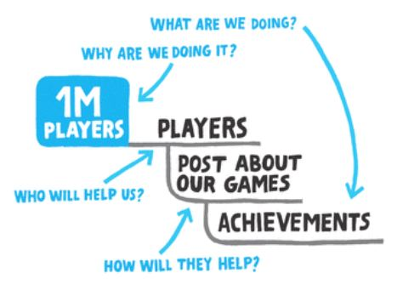
Mapping Step 1a: Determine the Actors: the “Who”
Take 8 Minutes To List Your Actors(s)
Add your highest priority goal to start the map
This is the “Why are we doing this”
Begin to answer the following types of questions
“Whose behavior do we want to impact?”
“Who can produce the desired effect”
“Who can obstruct it?”
“Who are the consumers or users of our product?”
Avoid generic actors like “People” or “Users”
“How should our actors’ behavior change to achieve this goal?”
“How can they help us to achieve the goal?”
“How can they obstruct us or prevent us from succeeding?”
“What can we do, as an organization or a delivery team, to support the required impacts?”
“What are the things that can be done?”
How much will this deliverable contribute to the goal?
WHY
WHO
HOW
WHAT

Slide 16
Mapping Step 1b: Determine the Impacts: the “How”
Take 10 Minutes To List Your Impacts
Add your highest priority goal to start the map
This is the “Why are we doing this”
Begin to answer the following types of questions
“Whose behavior do we want to impact?”
“Who can produce the desired effect”
“Who can obstruct it?”
“Who are the consumers or users of our product?”
Avoid generic actors like “People” or “Users”
“How should our actors’ behavior change to achieve this goal?”
“How can they help us to achieve the goal?”
“How can they obstruct us or prevent us from succeeding?”
“What can we do, as an organization or a delivery team, to support the required impacts?”
“What are the things that can be done?”
How much will this deliverable contribute to the goal?
WHY
WHO
HOW
WHAT

Slide 17
Mapping Step 1c: Determine Deliverables: the “What”
Take 10 Minutes To List Your Deliverables
Add your highest priority goal to start the map
This is the “Why are we doing this”
Begin to answer the following types of questions
“Whose behavior do we want to impact?”
“Who can produce the desired effect”
“Who can obstruct it?”
“Who are the consumers or users of our product?”
Avoid generic actors like “People” or “Users”
“How should our actors’ behavior change to achieve this goal?”
“How can they help us to achieve the goal?”
“How can they obstruct us or prevent us from succeeding?”
“What can we do, as an organization or a delivery team, to support the required impacts?”
“What are the things that can be done?”
How much will this deliverable contribute to the goal?
WHY
WHO
HOW
WHAT

Slide 18
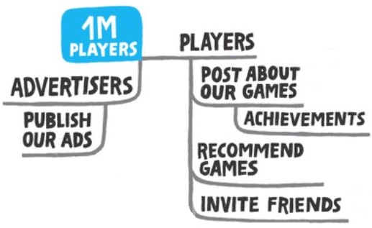
Mapping Step 2: Find Alternatives
Take 10 Minutes To List Alternatives
Timebox a conversation to define alternatives
The goal of this step is to find a better or cheaper solution, a shorter journey to the key objectives
Don’t criticize any ideas, just add them to the map
“What else could those guys do for us?”
“Who else can help?” “How?”
“Who can obstruct us?”
Ensure each alternative also has an assumption of impact listed with it.
The amount you believe this action will contribute towards our goal.

Slide 19
Mapping Step 3: Identify Key Priorities
Take 3 Minutes To Choose Your top 1-3 Key Priorities
Hold a discussion about the map
Look at possible obstructions: what are the crucial things that can get in our way
Is there a high-value low-hanging fruit impact somewhere?
What are the key assumptions to test?
Dot voting is very helpful in quickly identifying your top priorities
Could even use a color scheme such as red dots for “critical” items and green for “low-hanging fruit”

Slide 20
Mapping Step 4: Earn or Learn (Think Lean Startup!)
Define small experiments to test key assumptions, or create a User Story map to identify iterative delivery slices
What is the simplest way to perform the highest impact activity?
Unsure about the assumption, what is the simplest way to test it?
Could we test it without software?
Could we start earning with a partly manual process?

Slide 21
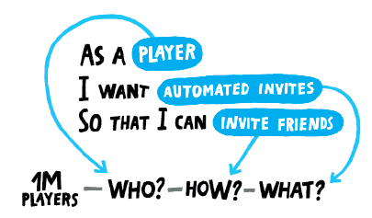
Create User Stories
Take 8 Minutes To Create a handful of User Stories
You can now create User Stories based on the Impact Map
Vote to rank the stories

Slide 22
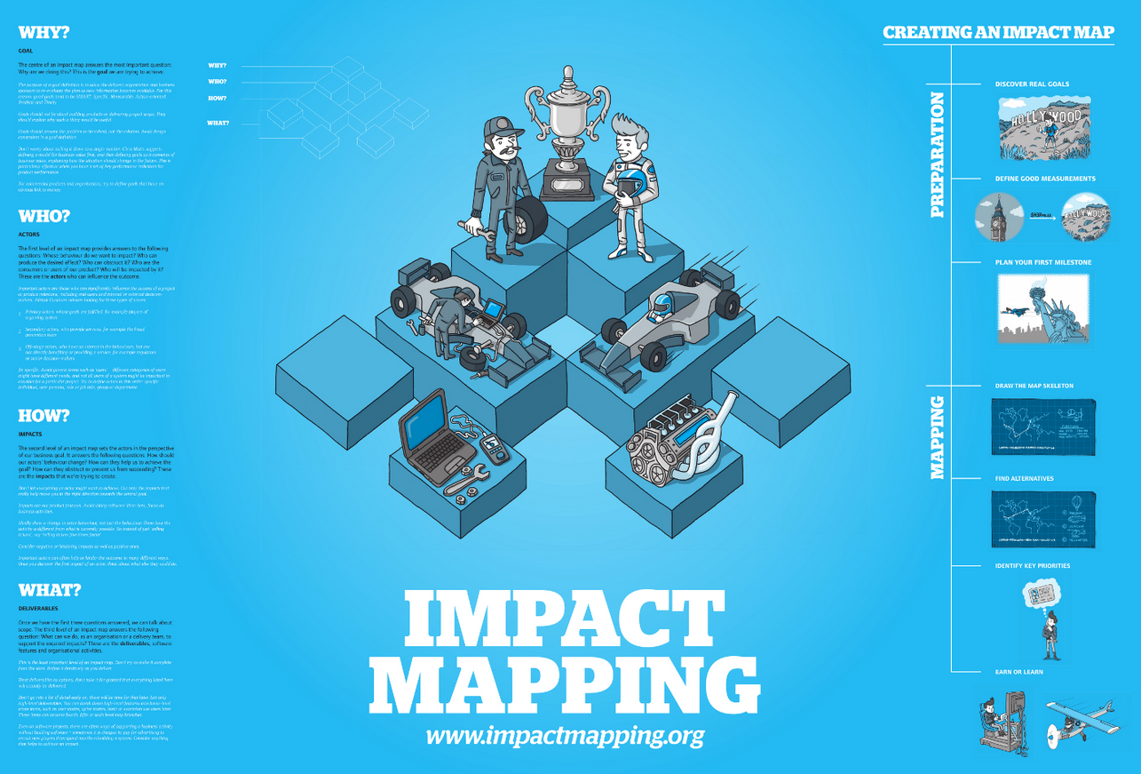
Pretty poster you can find at www.impactmapping.org
https://github.com/impactmapping/open-impact-mapping-workshop/blob/master/educational-workshops/concerts-online/handouts/poster-35x23inch.pdf

Slide 23

Questions & Answers
Contact Information:
John Hughes
Email: jhughes@sevatec.com
Email: jwhughesjr@gmail.com
Website: http://www.federalagilecoach.com/
Twitter: @jwhughesjr LinkedIn: www.linkedin.com/in/johnwhughesjr
Rachel Whitt
Email: rwhitt@sevatec.com
LinkedIn: www.linkedin.com/in/rachelewhitt

